Slide 1
Missionary
Final Report
Dr. Cho

Slide 2
Why Cambodia?
In 1993, I was a member of the Christian Dental Society (CDS). CDS asked members of the society to come to Cambodia to reopen a dental school that had been closed for about 25 years.
In August 2004, I answered the call. I arrived here as a member of the InnerChange/Church Resources Ministry. InnerChange is serving poor people all over the world.

Slide 3
Why Cambodia?
When I arrived in early 2004 to interview with the government dental head, there were 300 licensed dentists to serve 13 million people. The dental problem is very large in Cambodia.
Now there are 900 licensed dentists.

Slide 4
The Start of the Dental Clinic
In May 2005, I opened the dental clinic inside the Corporate Services International (CSI) military hospital close to Wat Phnom. And I started to treat poor patients and share the gospel with them.
CSI was joined by World Team and is now CSI-Mercy Medical Center, since 2008, and built a brand new hospital of their very own.

Slide 5
The Start of the Dental Clinic
Originally I wanted to teach in the dental school. But God’s plan was for me to serve the poor people, practicing dentistry, instead of teaching at the school.

Slide 6
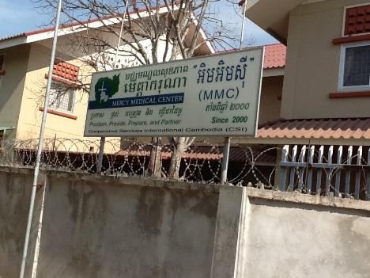

Slide 7
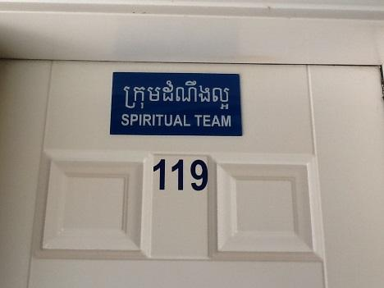

Slide 8
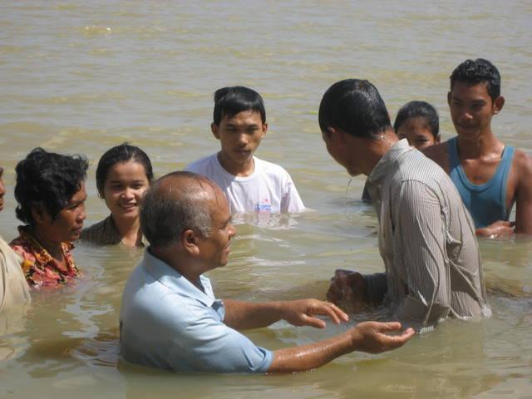

Slide 9
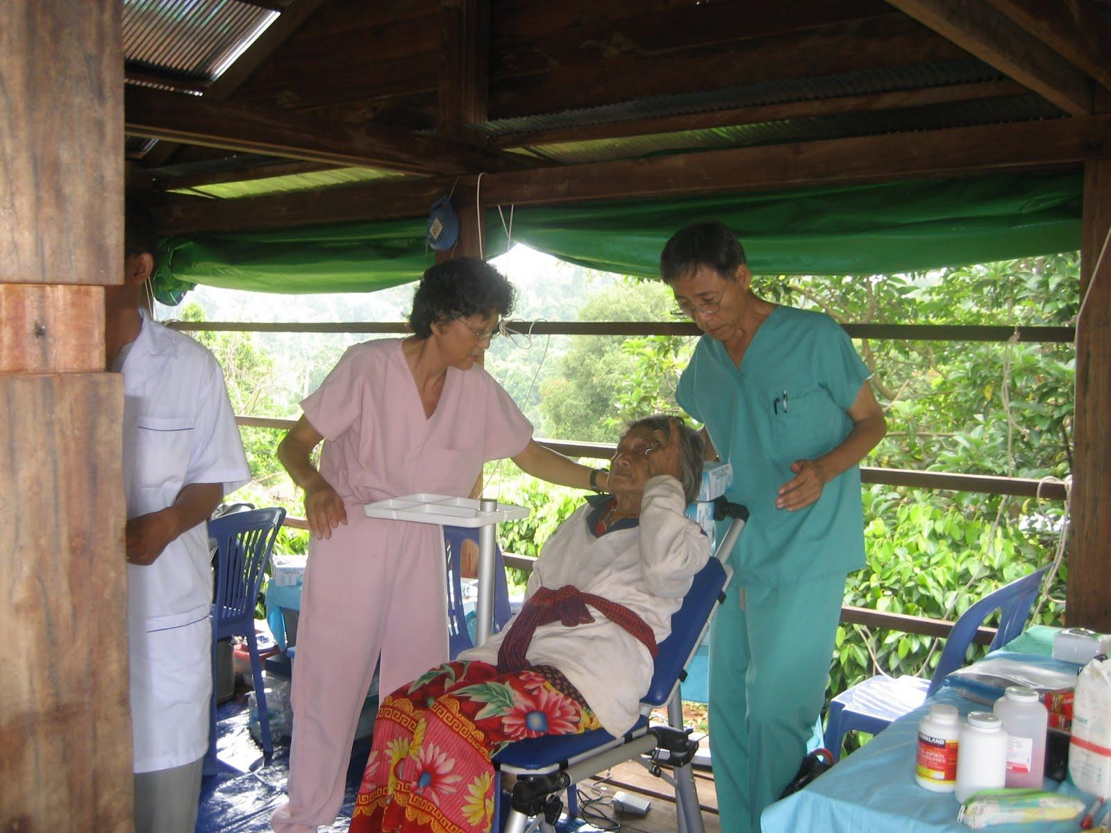
Mondulkiri during 2005

Slide 10
Mobile Clinics
I started doing mobile clinics to remote villages in 2006. I have been doing the mobile clinic about 6 times each year.
Often I invited some medical teams of doctors (not dentists) to go with us. We average about 400 dental patients and 800 medical patients on each site.

Slide 11
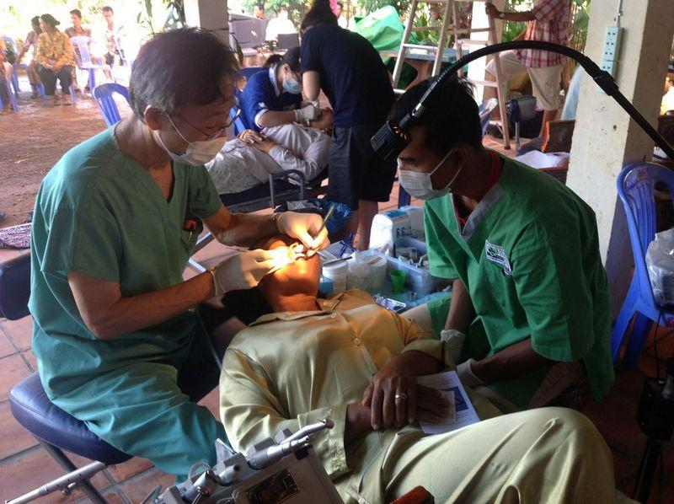

Slide 12
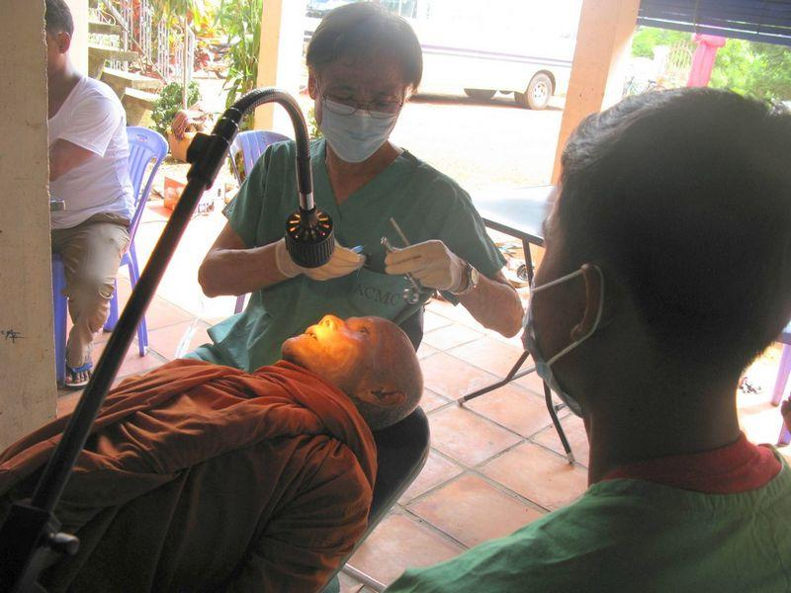

Slide 13
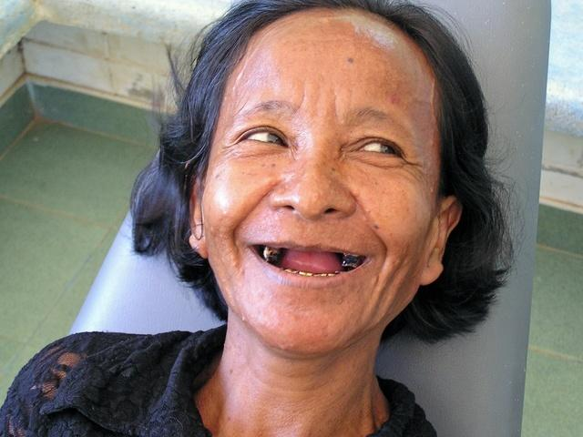

Slide 14
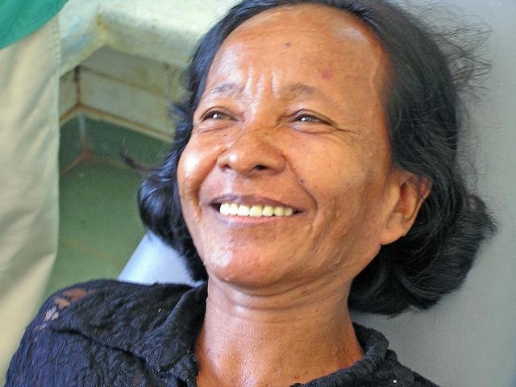
May 2007

Slide 15
A young mother would always cover her face out of embarrassment to cover her missing front teeth.
With new dentures, she now smiles brightly.

Slide 16
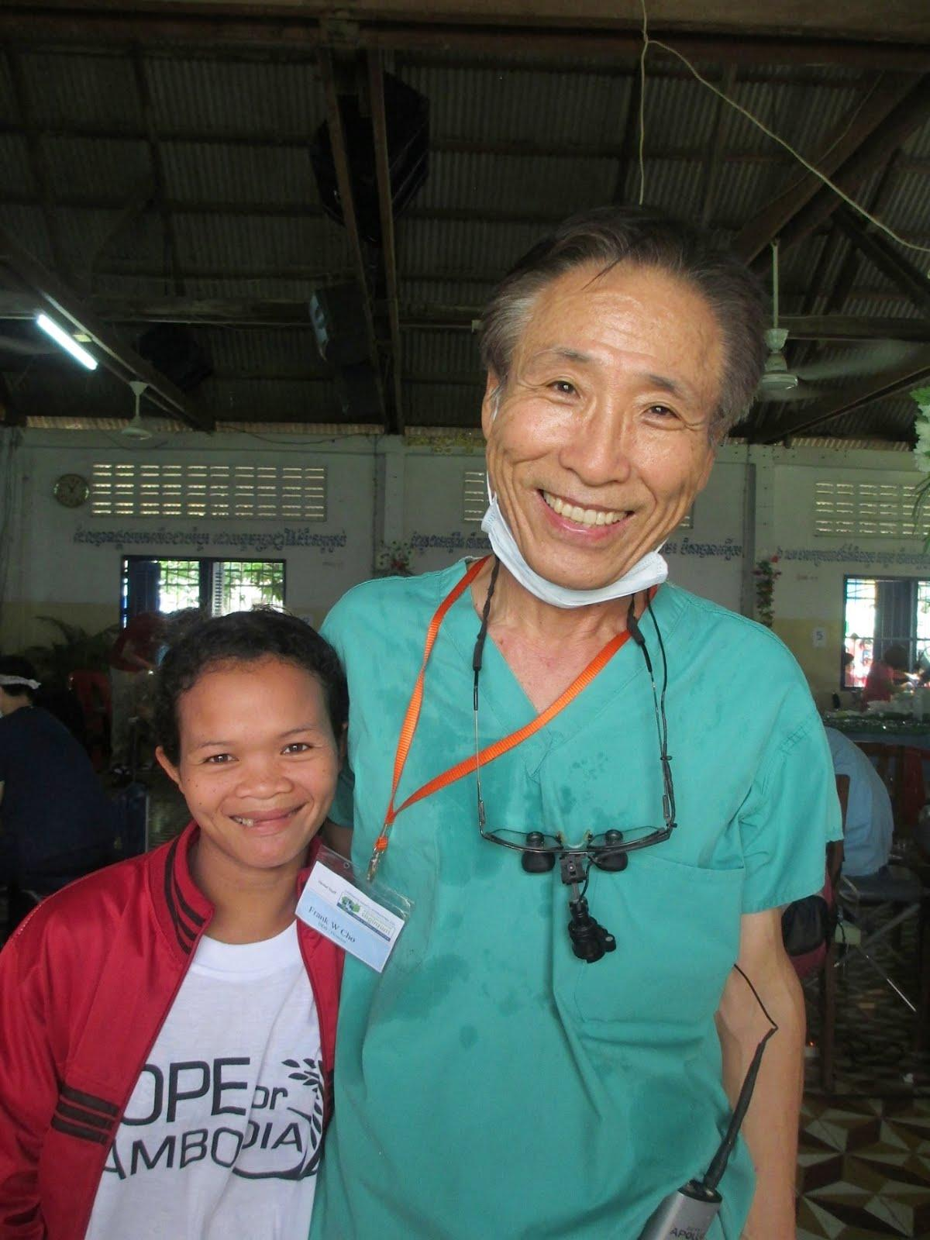

Slide 17
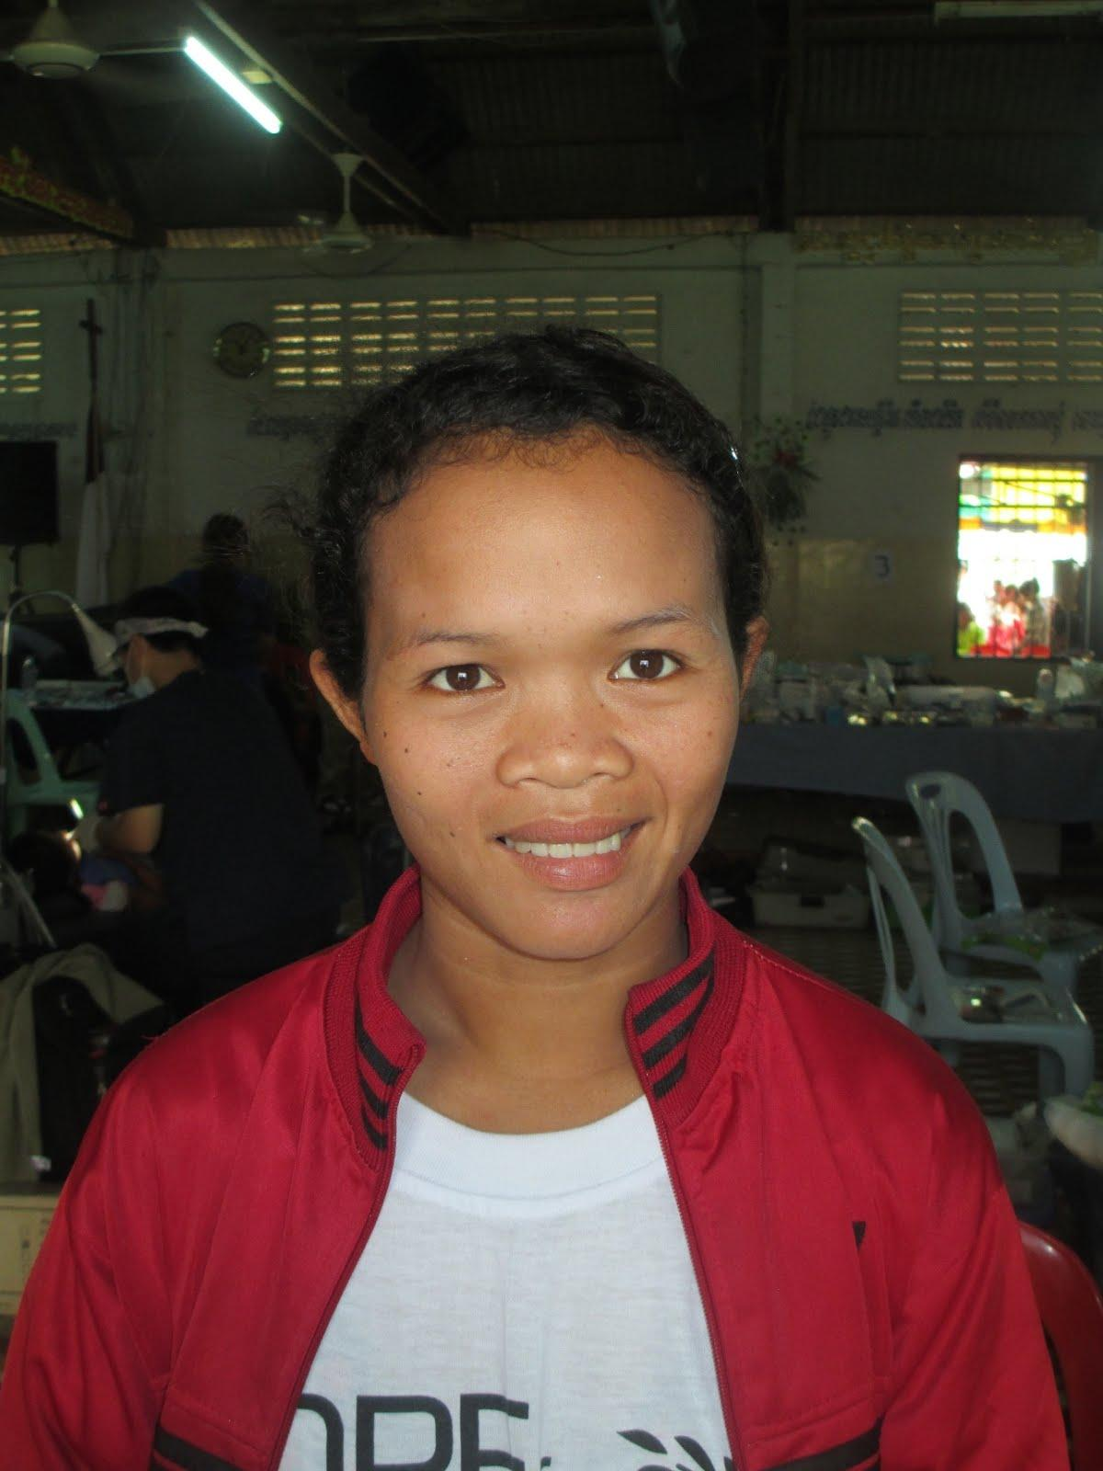
July 2014

Slide 18
William Her
In 2007, William Her came to serve as a lab technician to open a laboratory for me. He also taught as a technician.

Slide 19
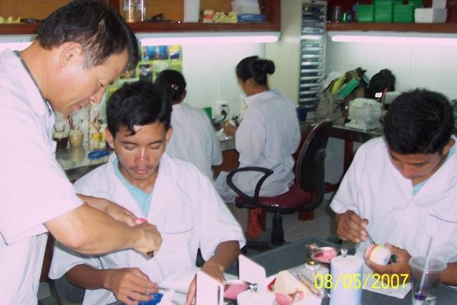

Slide 20
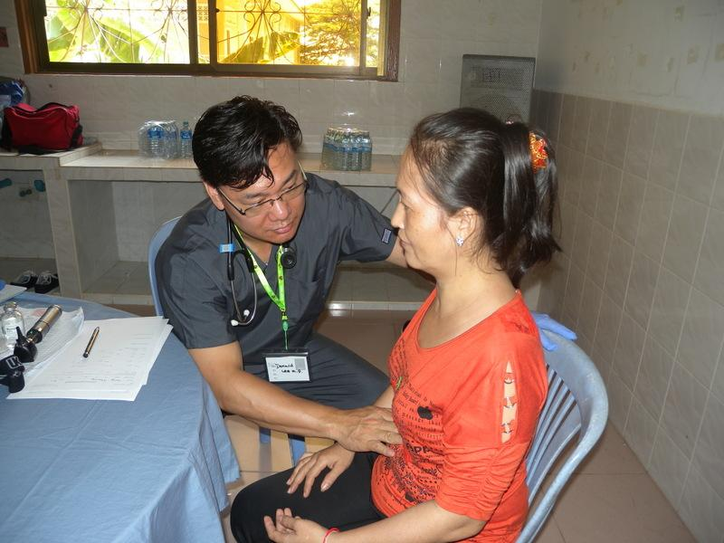

Slide 21
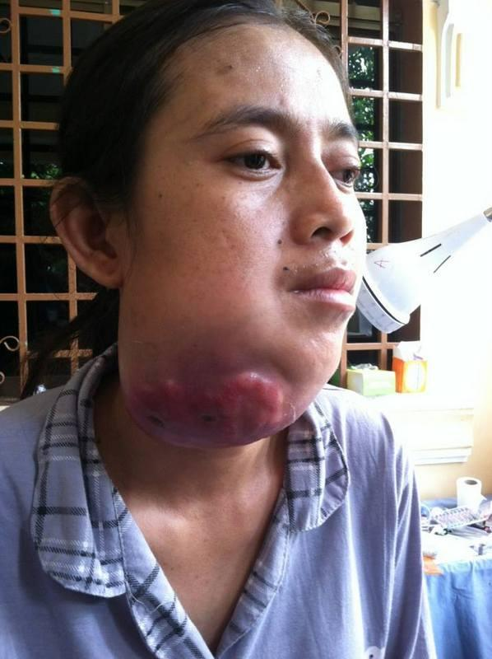

Slide 22
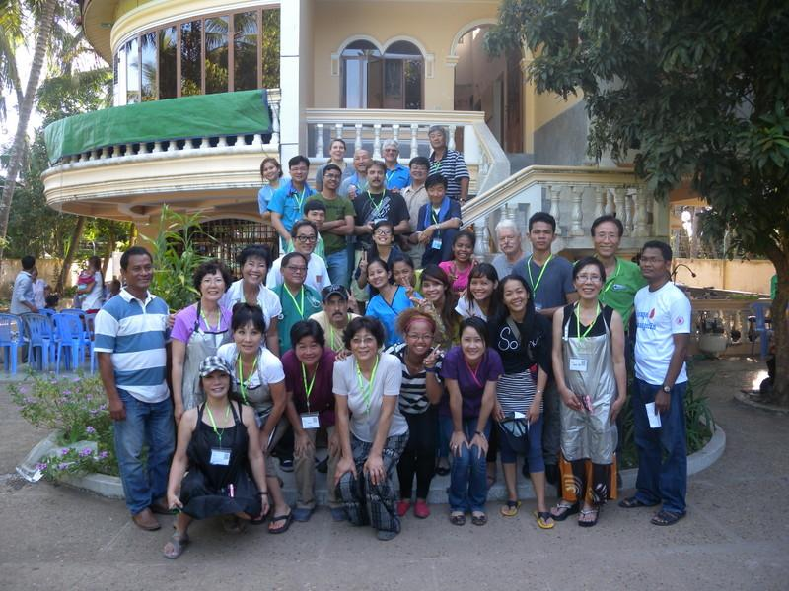

Slide 23
Teaching in Dental School
In my second term in 2009, I had the opportunity to teach the dental students at the International University dental school.
I still teach endodontic, partial denture and periodontology.

Slide 24
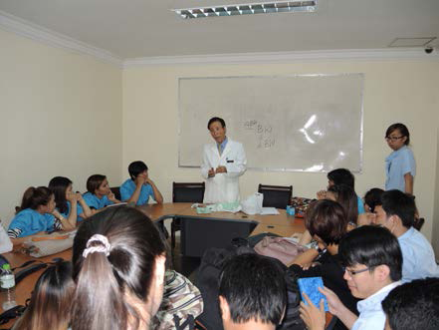

Slide 25
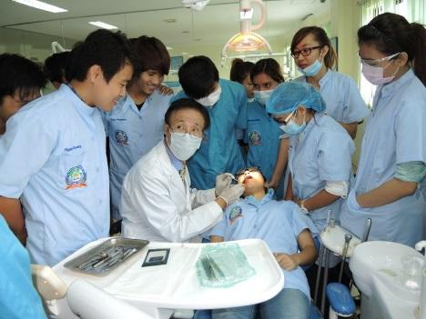

Slide 26
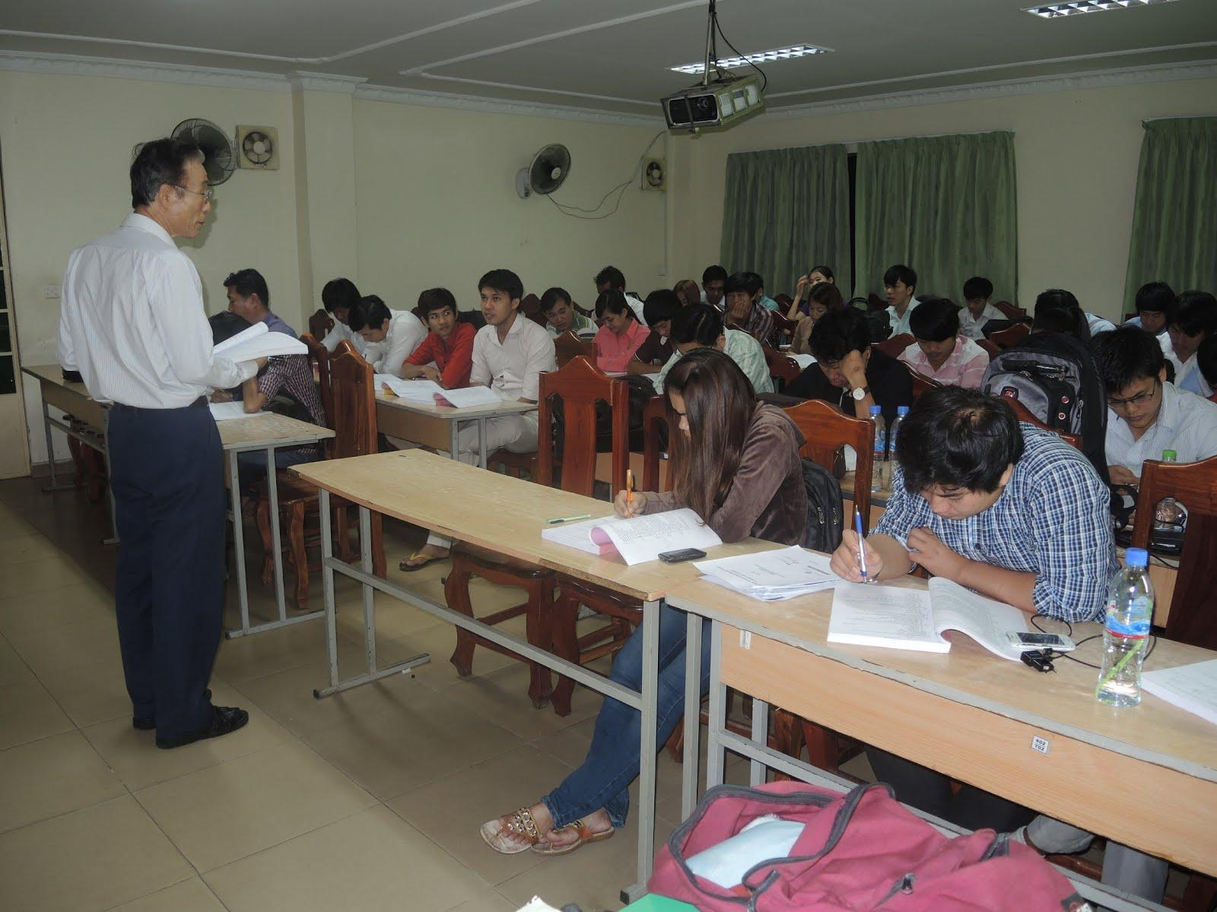

Slide 27
Home Bible Study
Inside the school, we are prohibited from conducting any religious activity. Buddhist activity is permitted, but Christian activity is not.
So I open a Bible study in my home. Christian professors and I also disciple students at a café.

Slide 28
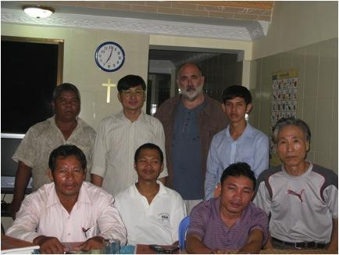

Slide 29
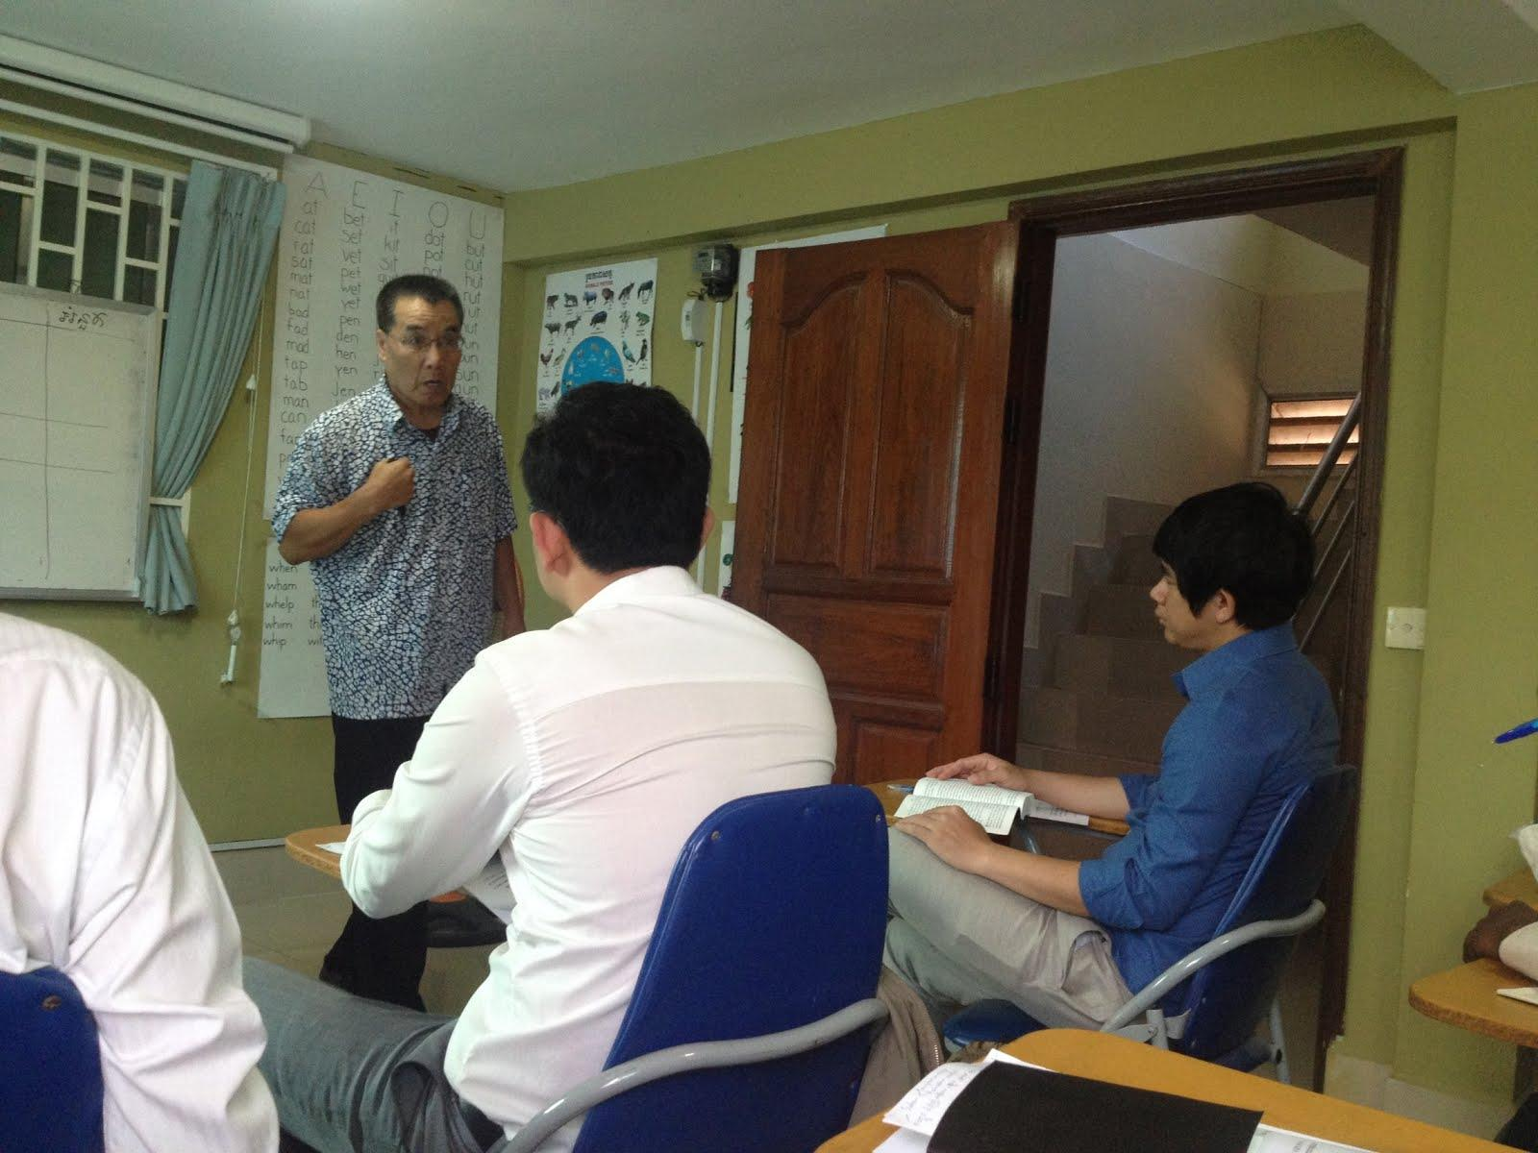

Slide 30
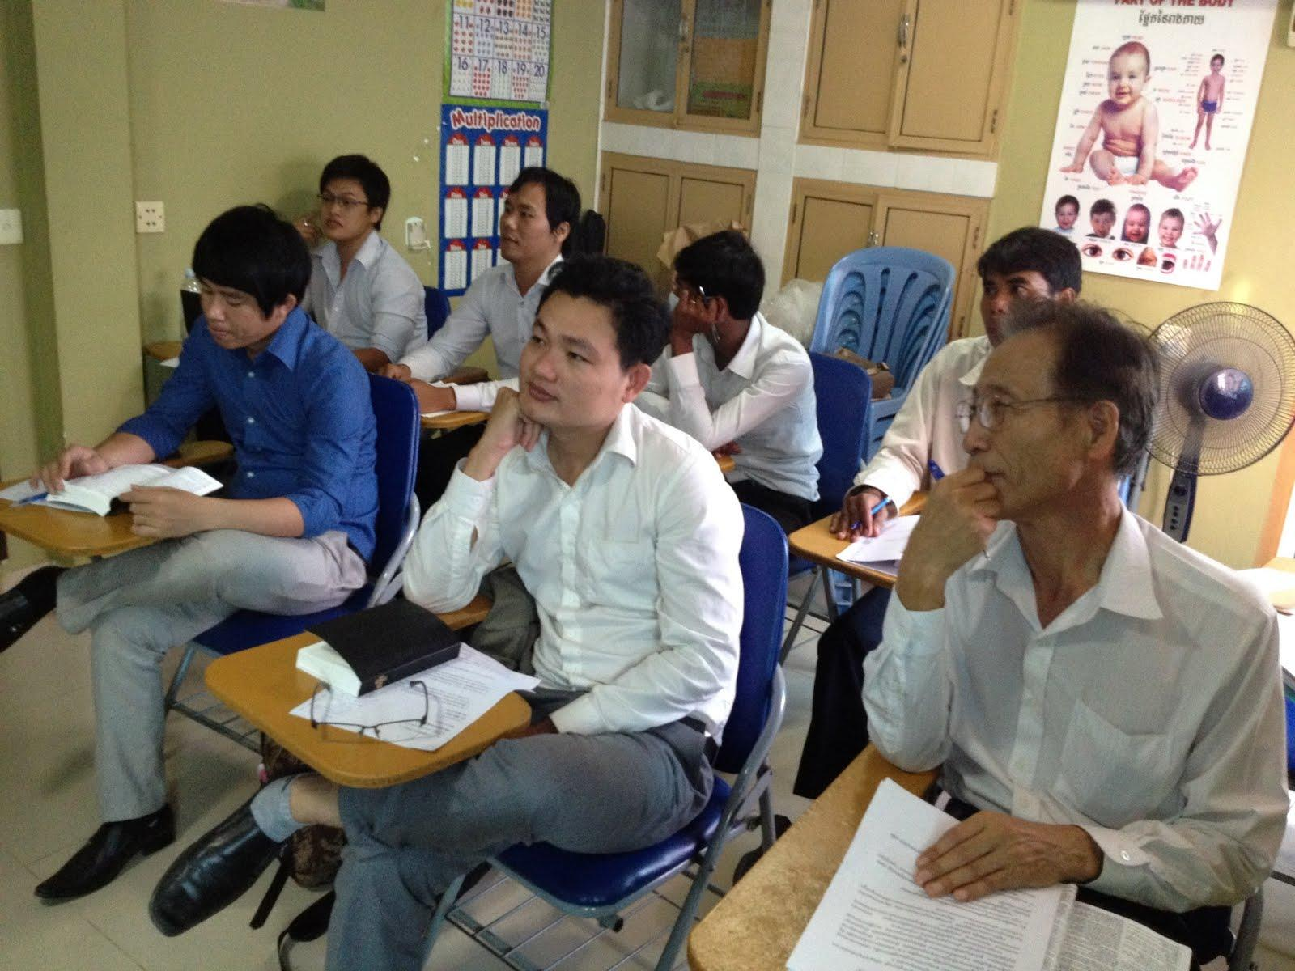

Slide 31
American Dental Clinic
In May 2009, I started the American Dental Clinic in Tuol Kouk. This is a for-profit clinic. The main function of this clinic is to help fund the MMC clinic and the mobile clinics, and it is a place for training the student and dental staff.
We have US qualified trainers come and train implant techniques to the dental staff while students watch and learn.

Slide 32
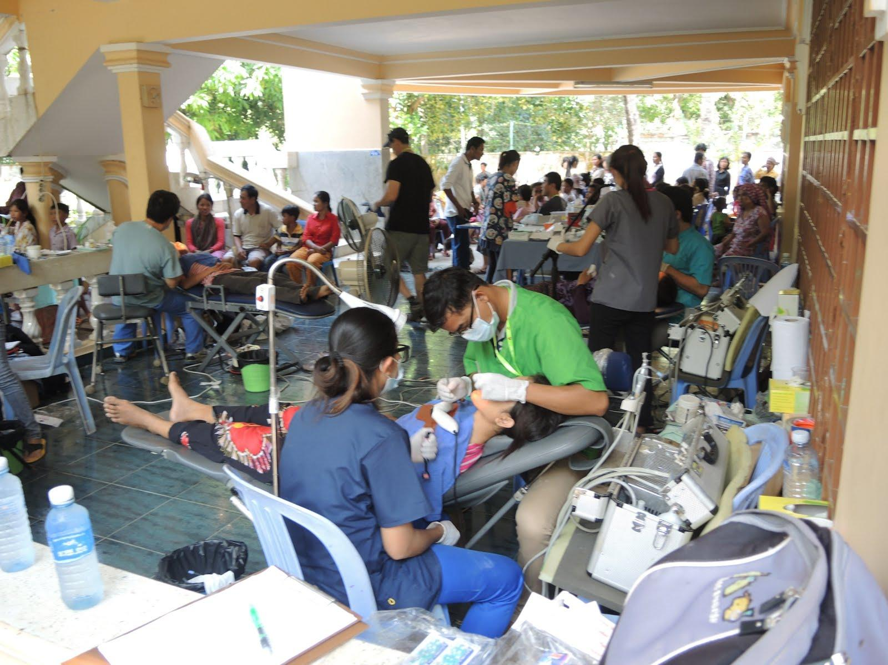
October 2013

Slide 33
Tom Love
Tom Love is an oral surgeon who is a great supporter of our ministry, together with his wife. He comes every year to help the mobile clinic.

Slide 34
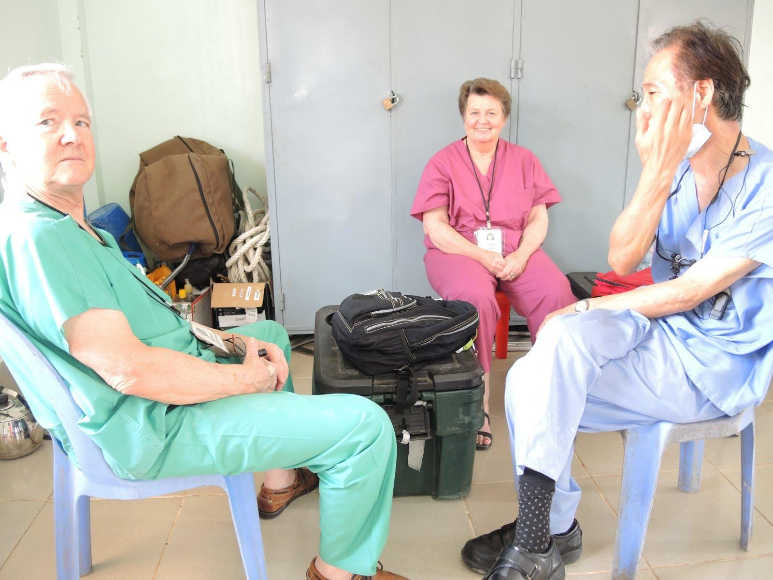
Tom Love (left)

Slide 35
David Koo
David Koo was my replacement for my ministry, but was called to Iraq. I am currently searching for a new replacement.

Slide 36
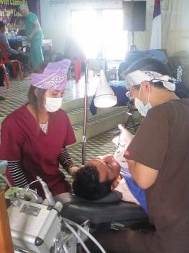
David Koo (right)
7/2014

Slide 37
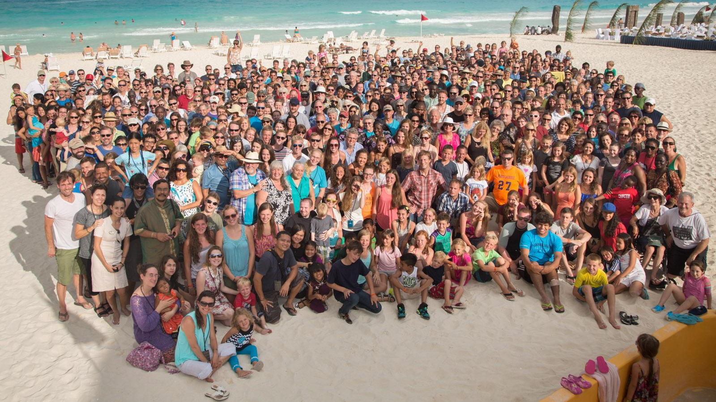
CRM Family

Slide 38
Movement of God
Protestant Church - Self-inflicted handicap
Modality vs. Sodality
430,000 Total Missionaries
158,000 of which are protestant
Apostolic People & Apostolic Structure

Slide 39
Come to me who are weary and burdened and I will give you rest.
Matt 11:08

Slide 40
Future Plans
I left CRM after 10 years of participation. I will no longer be part of the mobile clinics—that will be for my replacement.
I will be focusing on teaching at the dental school, now under CDS (Christian Dental Society). I will also be finishing my endo- master program.

